Slide 1
Regression
Linear Regression

Slide 2
We will talk about…
Introduction
Hypothesis of linear regression
Assumption of regression
Properties of regression line
Advantages of linear regression
Limitations of linear regression
Data preparation for linear regression
Regression Model Evaluation Metrics

Slide 3


Introduction
Linear regression is one of the most basic types of regression in supervised machine learning. The linear regression model consists of a predictor variable and a dependent variable related linearly to each other. We try to ﬁnd the relationship between independent variable (input) and a corresponding dependent variable (output).
This can be expressed in the form of a straight line
Linear regression, also known as ordinary least squares (OLS) and
linear least squares, is the real workhorse of the regression world

Slide 4
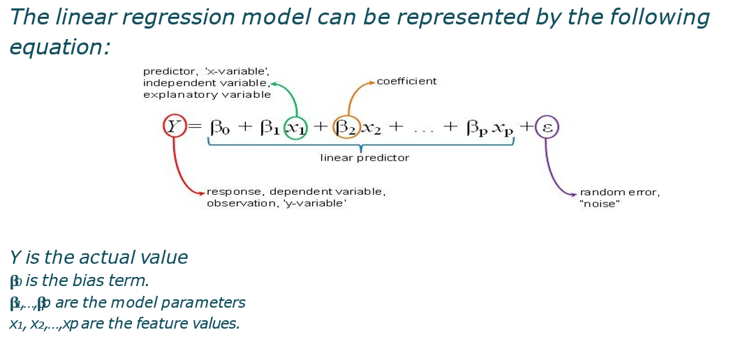
Hypothesis of Linear Regression

Slide 5
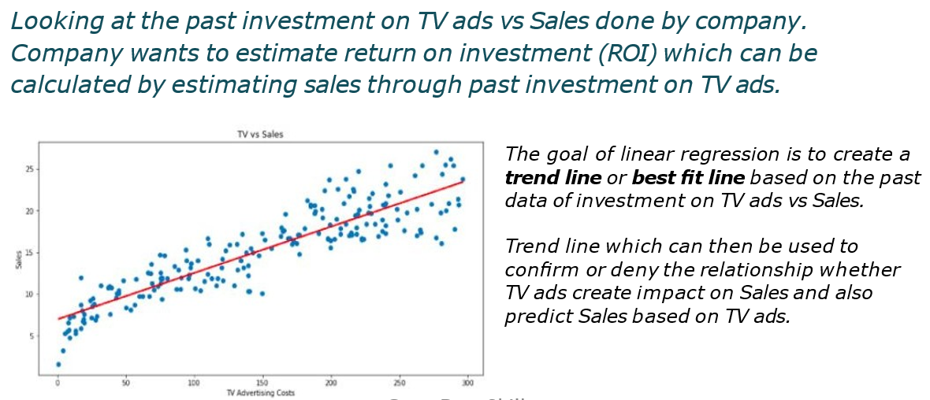
ROI of TV ads?

Slide 6
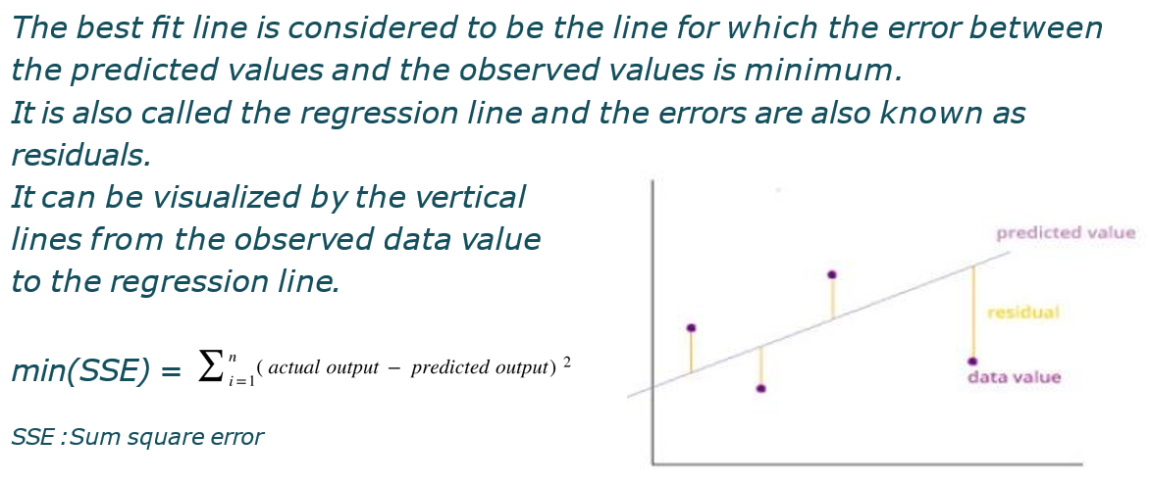
How do we determine best fit line?

Slide 7
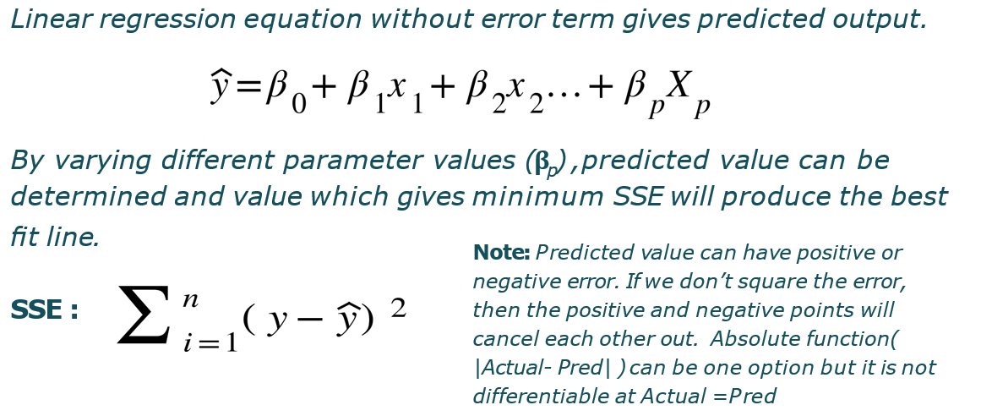
Predicted Output?

Slide 8
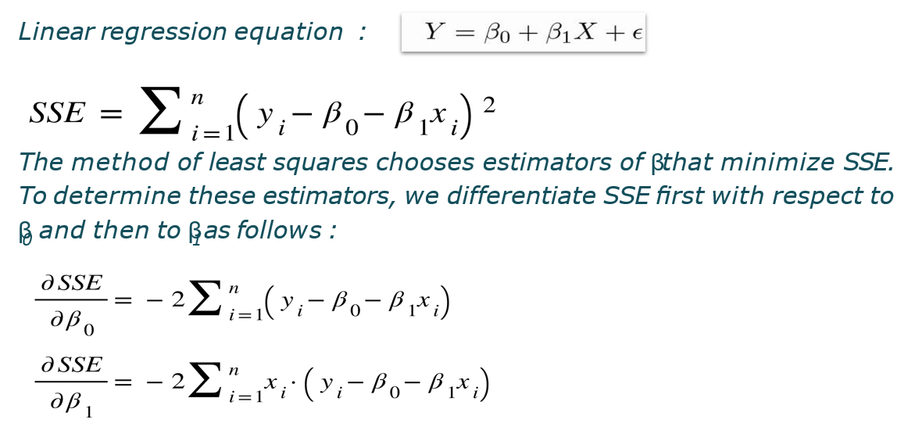
Least squares Estimator of Parameters

Slide 9
In Normal equation, we differentiate and equate to 0 and will try to find out beta and the value will be minimum.
In gradient descent, we make the function and take partial derivative
If mean square error function is represent by j then,
β1 = β – α (dj/d β1) ….. βp = β – α (dj/d βp)
When we have linear function will use normal equation and when we have polynomial and other function will use gradient descent

Slide 10
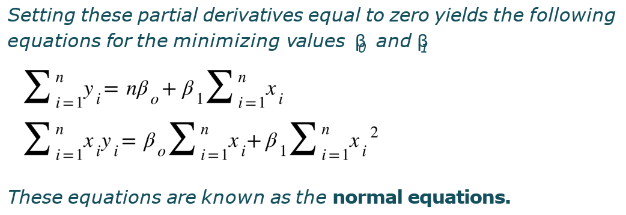
Derivative = 0

Slide 11
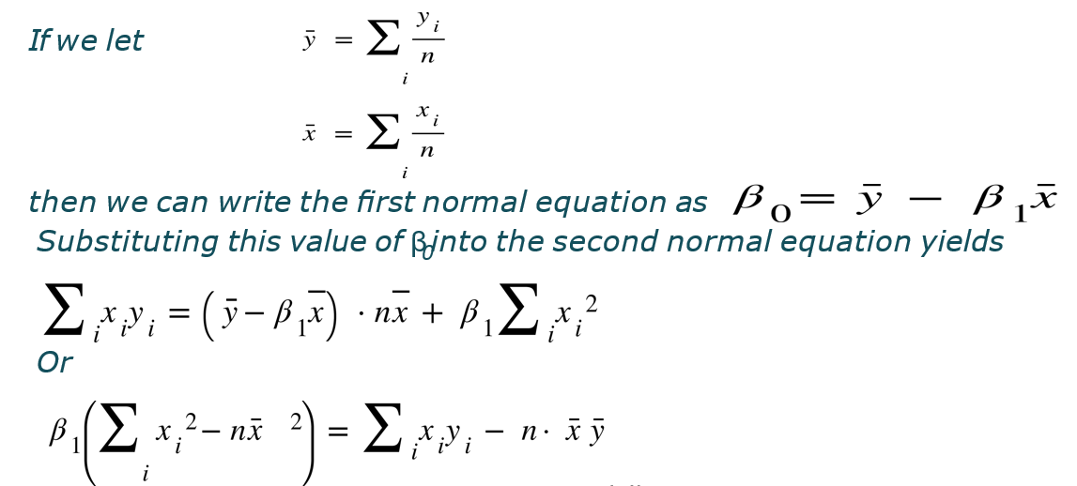

Slide 12
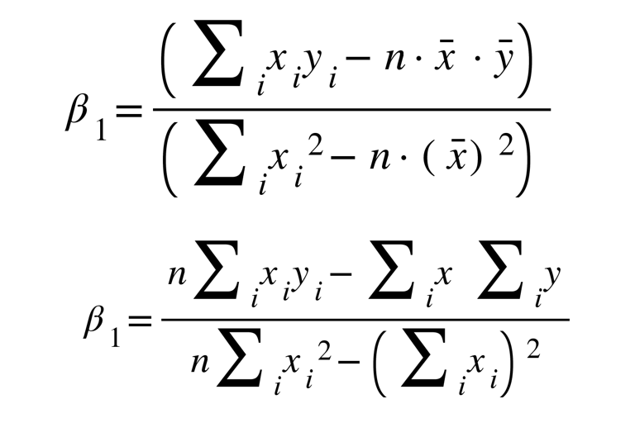

Slide 13
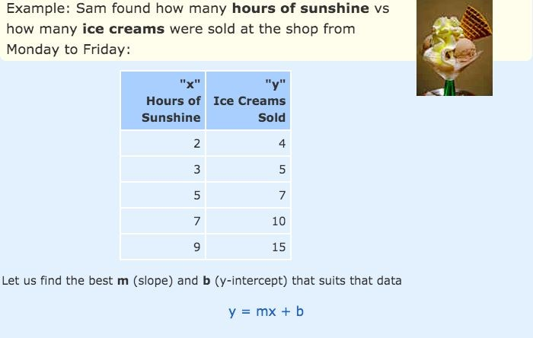
Example

Slide 14
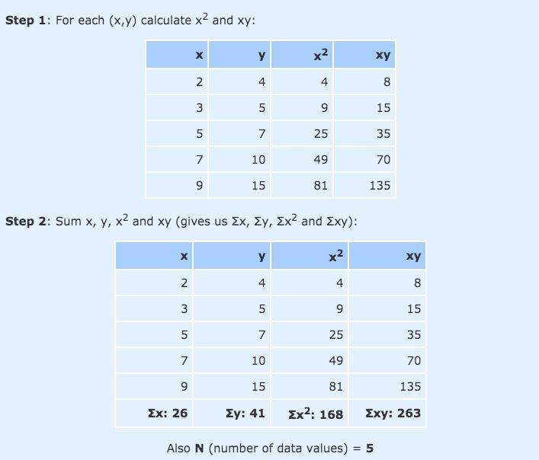

Slide 15
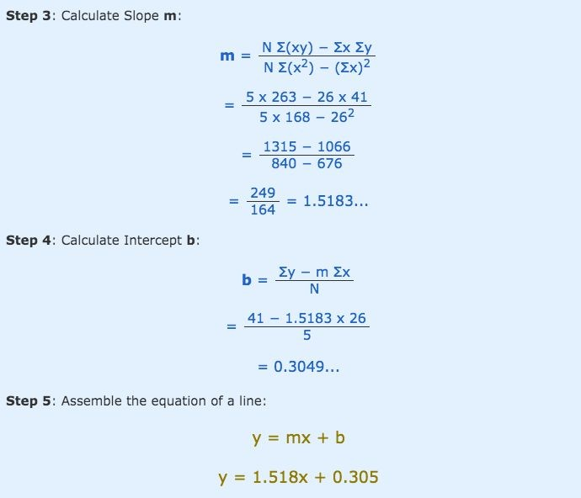

Slide 16
Best possible 𝛽_{p}
With inﬁnite possibilities of values which parameter can take, how do we arrive at the best possible 𝛽_{p} with minimum iteration.
Gradient Descent is an optimization algorithm that helps machine learning models to ﬁnd out paths to a minimum value using repeated steps.
Gradient descent is used to minimize a function so that it gives the lowest output of that function. This function is called the Loss Function.

Slide 17
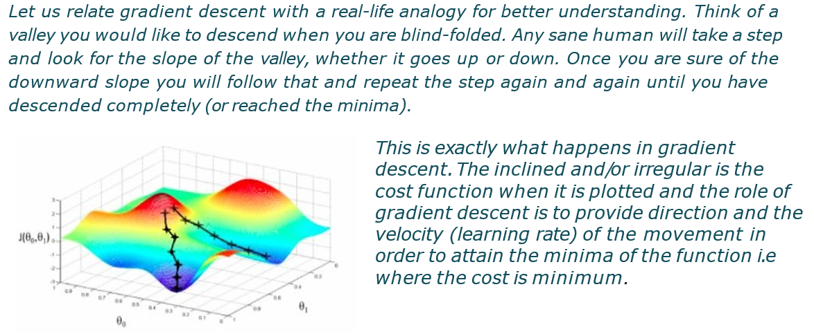
Gradient Descent

Slide 18
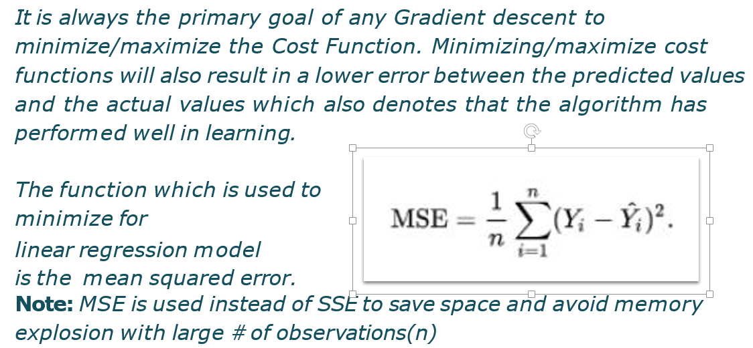
How does Gradient Descent Work?

Slide 19
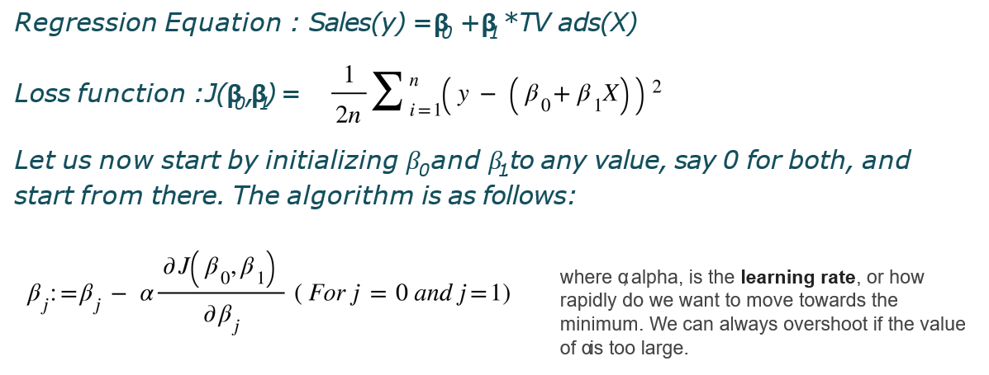
Initialize

Slide 20
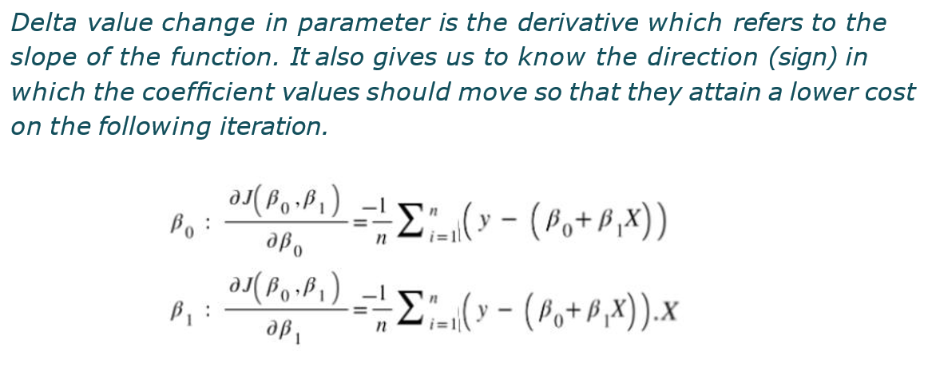
Delta

Slide 21
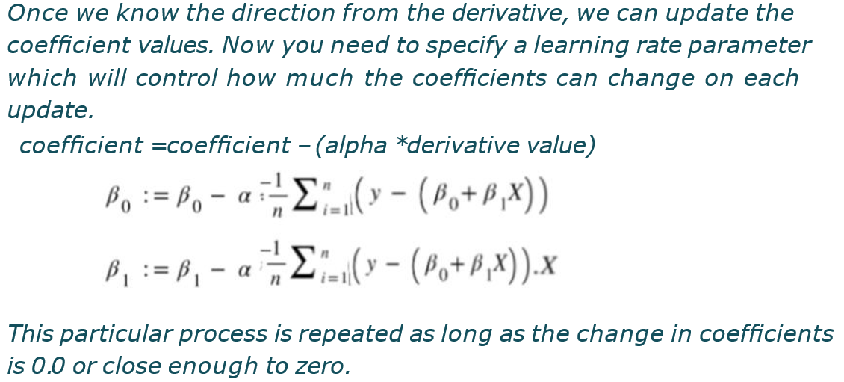
Repeat until Convergence

Slide 22
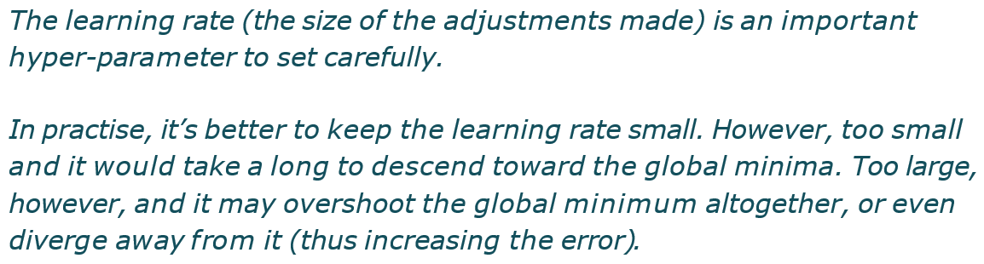
Learning Rate (𝛂)

Slide 23
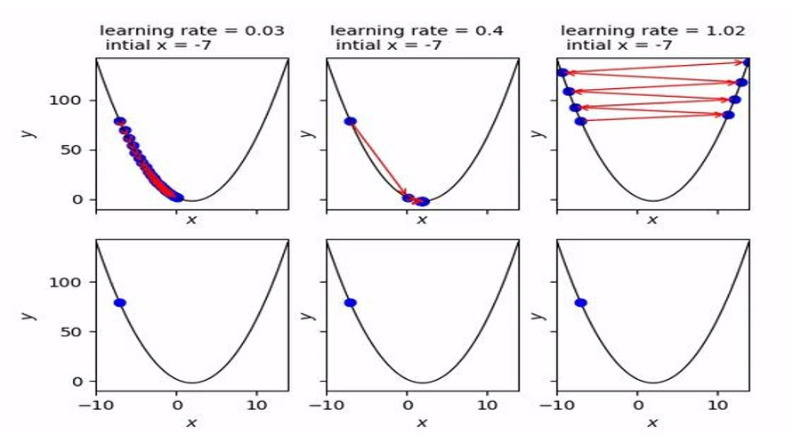

Slide 24
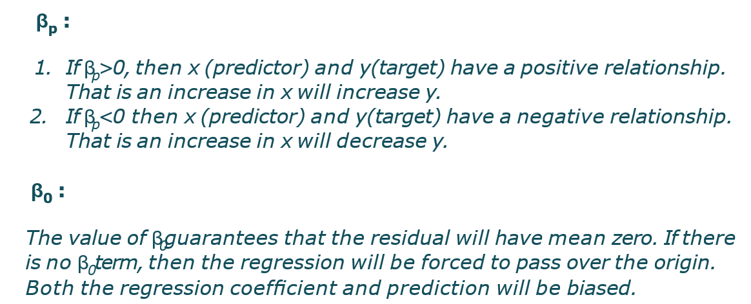
Exploring β

Slide 25
Assumption of Regression Line
The relation between the dependent and independent variables should be almost linear.
Mean of residuals should be zero or close to 0 as much as possible. It is done to check whether our line is actually the line of “best ﬁt”.
There should be homoscedasticity or equal variance in a regression model. This assumption means that the variance around the regression line is the same for all values of the predictor variable (X).
There should not be multicollinearity in regression model. Multicollinearity generally occurs when there are high correlations between two or more independent variables.

Slide 26
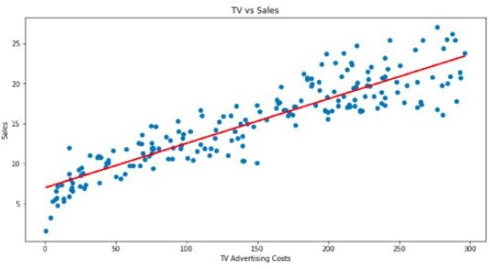
Linear Relationship

Slide 27
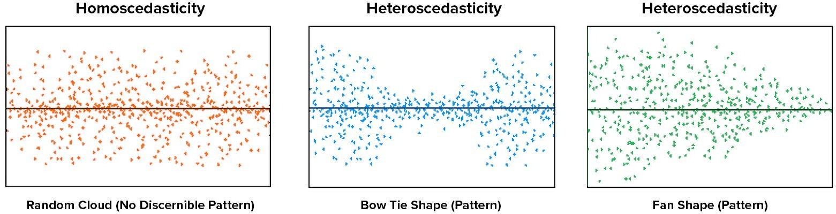
Homoscedasticity
Homoscedasticity (meaning “same variance”) describes a situation in which the error term is the same across all values of the independent variables.
Heteroscedasticity (the violation of homoscedasticity) is present when the size of the error term differs across values of an independent variable. (Scatter plot : Residual vs Fitted value)
Imagine you're trying to predict someone's income based on their years of education. If the spread of income values (the error terms) is the same regardless of the years of education, then the data is homoscedastic.

Slide 28
What if Heteroscedasticity?
Heteroscedasticity does not cause bias in the coefﬁcient estimates, it does make them less precise.
Dealing with Heteroscedasticity:
Log-transformation of features
Outlier treatment
Try polynomial ﬁt

Slide 29
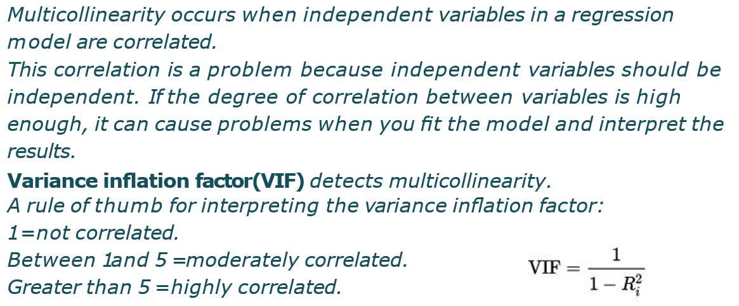
Multicollinearity

Slide 30
What if Multicollinearity?
Remove some of the highly correlated independent variables.
Linearly combine the independent variables, such as adding them together.
Perform an analysis designed for highly correlated variables, such as principal components analysis

Slide 31
Properties of Regression Line
Regression line passes through the mean of independent variable (x) as well as mean of the dependent variable (y).
β_{p} explains the change in Y with a change in x by one unit. In other words, if we increase the value of ‘x’ it will result in a change in value of Y.
The regression constant (β₀) is equal to the y intercept of the regression line.
The line minimizes the sum of squared differences between observed values (the y values) and predicted values (the ŷ values computed from the regression equation).
Note: The least squares regression line is the only straight line that has all of these properties.

Slide 32
Advantages of Linear Regression
Linear regression is simple to implement and easier to interpret the output coefﬁcients
When you know the relationship between the independent and dependent variable is linear, this algorithm is the best to use because it’s less complex as compared to other algorithms
It works well irrespective of data size

Slide 33
Limitations of Linear Regression
Outliers can have huge effect on the regression line.
Linear regression assumes a linear relationship between dependent and independent variables, which is not the case in most of the real world problems.
Prone to underﬁtting - Linear regression sometimes fails to capture the underneath pattern in data properly due to simplicity of the algorithm.

Slide 34
Data Preparation for Linear Regression
Linear Assumption: Linear regression assumes that the relationship between your independent and dependent is linear. It does not support anything else. This may be obvious, but it is good to remember when you have a lot of attributes. You may need to transform data to make the relationship linear (e.g. log transform for an exponential relationship).
Remove Outlier: Linear regression assumes that your independent and dependent variables are not noisy. Consider using data cleaning operations that let you better expose and clarify the signal in your data. This is most important for the output variable and you want to remove outliers in the output variable (y) if possible.
Remove Collinearity: Linear regression will over-ﬁt your data when you have highly correlated input variables. Consider calculating pairwise correlations for your input data and removing the most correlated.
Rescale Inputs: Linear regression will often make more reliable predictions if you rescale input variables using standardization or normalization.

Slide 35
Regression Model Evaluation Metrics
After the model is built, if we see that the difference in the values of the predicted and actual data is not much, it is considered to be a good model and can be used to make future predictions.
Few metric tools we can use to calculate error in the model
MSE (Mean Squared Error)
RMSE (Root Mean Squared Error)
MAE (Mean Absolute Error)
MAPE (Mean Absolute Percentage Error)
R² (R – Squared)
Adjusted R²

Slide 36
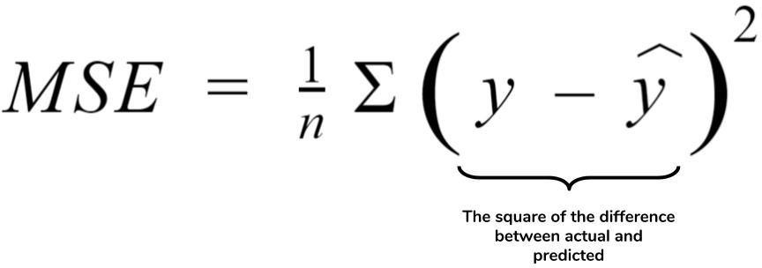
1. Mean Squared Error (MSE)
MSE or Mean Squared Error is one of the most preferred metrics for regression tasks. It is simply the average of the squared difference between the target value and the value predicted by the regression model.

Slide 37
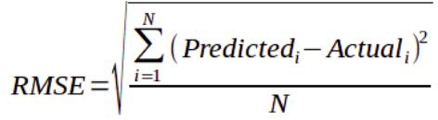
2. Root Mean Squared Error (RMSE)
RMSE is the most widely used metric for regression tasks and is the square root of the averaged squared difference between the target value and the value predicted by the model. It is preferred more in some cases because the errors are ﬁrst squared before averaging which poses a high penalty on large errors.

Slide 38
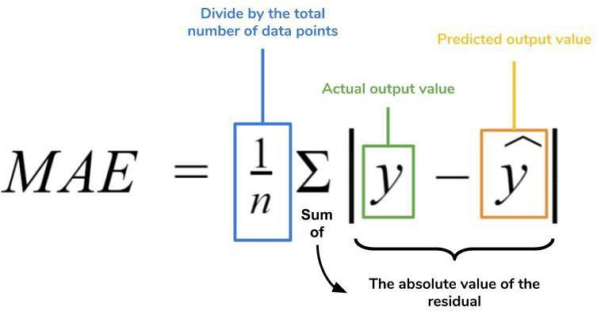
3. MAE (Mean Absolute Error)
MAE is the absolute difference between the target value and the value predicted by the model. The MAE is more robust to outliers and does not penalize the errors as extremely as MSE. MAE is a linear score which means all the individual differences are weighted equally.
It is not suitable for applications where you want to pay more attention to the outliers.

Slide 39
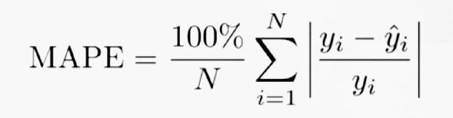
4. MAPE (Mean Absolute Percentage Error)
The mean absolute percentage error (MAPE), also known as mean absolute percentage deviation (MAPD), is a measure of prediction accuracy of a forecasting method in statistics, for example in trend estimation, also used as a loss function for regression problems in machine learning.

Slide 40
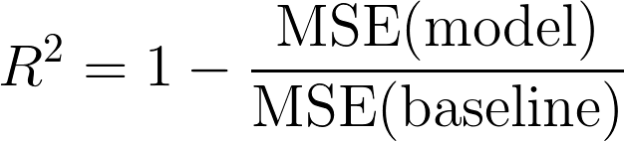
4. R² (R – Squared)
Coefﬁcient of Determination or R² is another metric used for evaluating the performance of a regression model. The metric helps us to compare our current model with a constant baseline and tells us how much our model is better.
The constant baseline is chosen by taking the mean of the data and drawing a line at the mean. R² is a scale-free score that implies it doesn't matter whether the values are too large or too small, the R² will always be less than or equal to 1.

Slide 41
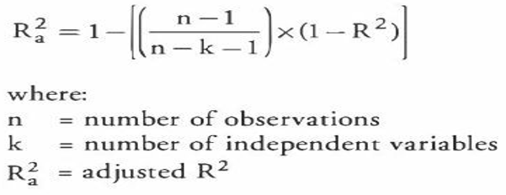
5. Adjusted R²
Adjusted R² depicts the same meaning as R² but is an improvement of it. R² suffers from the problem that the scores improve on increasing terms even though the model is not improving which may misguide the researcher.
Adjusted R² is always lower than R² as it adjusts for the increasing predictors and only shows improvement if there is a real improvement.

Slide 42
Properties of R²
R² ranges between 0* to 1.
R² of 0 means that there is no correlation between the dependent and the independent variable.
R² of 1 means the dependent variable can be predicted from the independent variable without any error.
An R² of 0.20 means that 20% variance in Y is predictable from X; an R² of 0.40 means that 40% variance is predictable.
*Note : R² score may range from -∞ to 1 if OLS is not used to get the predictions.

Slide 43
Important Library
Data Analysis :- Pandas
Statistical Analysis :- Statsmodels , numpy
Machine Learning :- Scikit learn
Deep Learning:- pytorch / tensorflow , keras
Gen AI :- langchain

